Slide 1

Notes:
-Phase 3 ~ Frontend
-Semi Prototype Frontend for the CTF Backend for Phase 2
-Used Figma for Designing
-Home Page ~ Welcomes the User

Slide 2
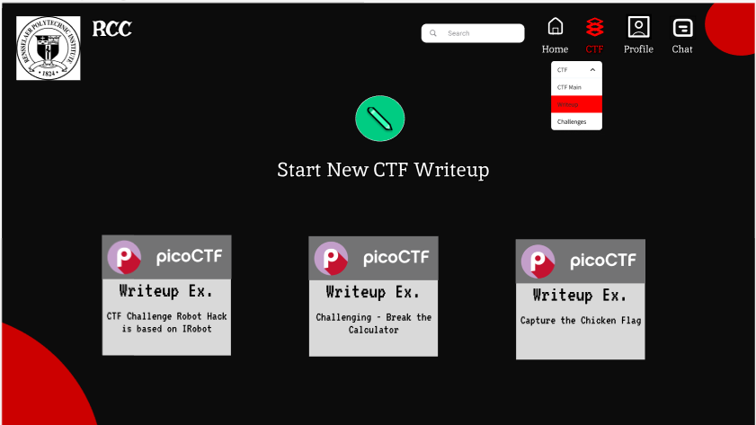
Notes:
-CTF Writeup Page
-User can create a CTF Challenge
-For example ~ Writeup Example 1 : CTF Challenge Robot Hack” Challenge

Slide 3
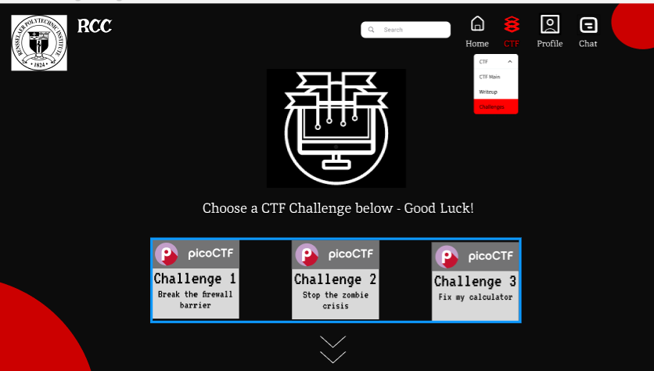
Notes:
-CTF Challenges page
-User can choose a challenge to play
-For Example – “Challenge 1 : Break the firewall barrier”

Slide 4
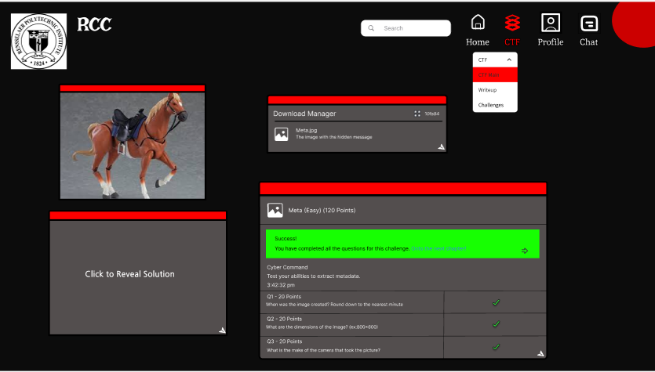
Notes:
-CTF Main Page
-This is example of what a challenge would look like

Slide 5

Notes:
-Profile Page
-This is how my profile would look like
-Press Right arrow…

Slide 6
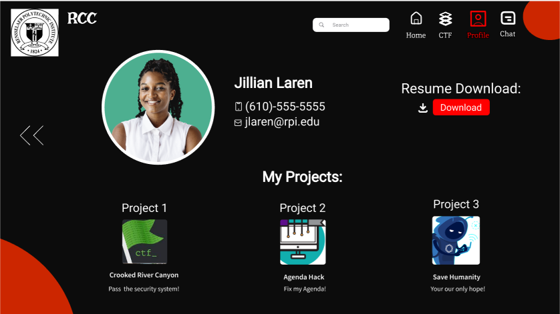
Notes:
-More in depth profile page
-Has image of user, phone number, email, etc
-You can download the resume
-See projects user worked on

Slide 7
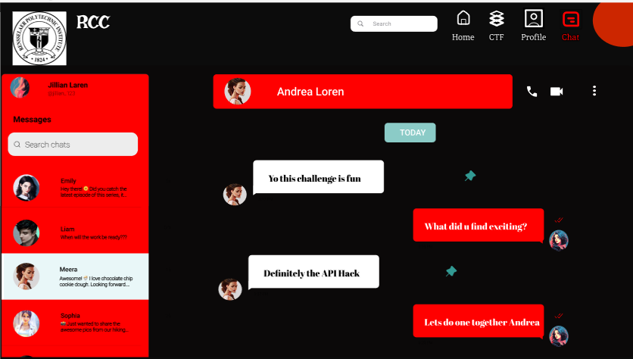
Notes:
-Chat page
-Users can interact with each other
-Here is an example of a conversation between the user and Andrea
THIS IS LAST SLIDE – FINISH UP!!!!!!!!

